Slide 1
Temporal phosphorylation and network analysis of yeast signaling
Speaker: Dylan Cronin
Home Institution: Bowling Green State University
Instructor: Dr. Anthony Gitter
Mentor: Nafisah Islam
Department of Biostatistics and Medical Informatics at the University of Wisconsin-Madison

Slide 2
How do proteins interact with one another?
ATP
ADP
P
Kinase
OFF
ON
Notes:
Protein interactions most often occur through phosphorylation.
A Phosphate group is added onto the protein via a kinase
This phosphate group often can make this protein change shape.
Conformational change can allow for the interaction with other proteins, and then cause a cascade of interactions.

Slide 3
What are protein-protein interaction networks?
Notes:
Protein-Protein interactions are often represented by some sort of graph. Where each of the circles here represents some sort of protein, and the lines in between them, called edges, represent an interaction between the two proteins. Interactions can be anything from phosphorylation to ubiquitination, but more often than not, the interaction between two proteins is phosphorylation.
First, there is some kind of stimulus to the cell, which binds to these receptor proteins.
The receptor proteins then most likely interact with proteins within the cell.

Slide 4
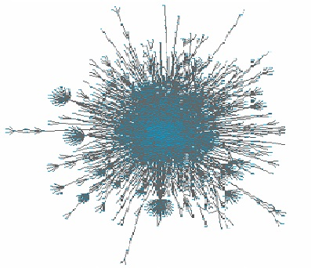
Why analyze protein interaction networks?
Allows one to identify what proteins are involved for particular cellular responses.
Network analysis has the potential to create a method to prevent a particular cellular response by inhibiting specific proteins.

Slide 5
Is the Temporal Pathway Synthesizer effective in using temporal phosphoproteomic data to determine the osmotic stress response protein signaling pathway in yeast?

Slide 6
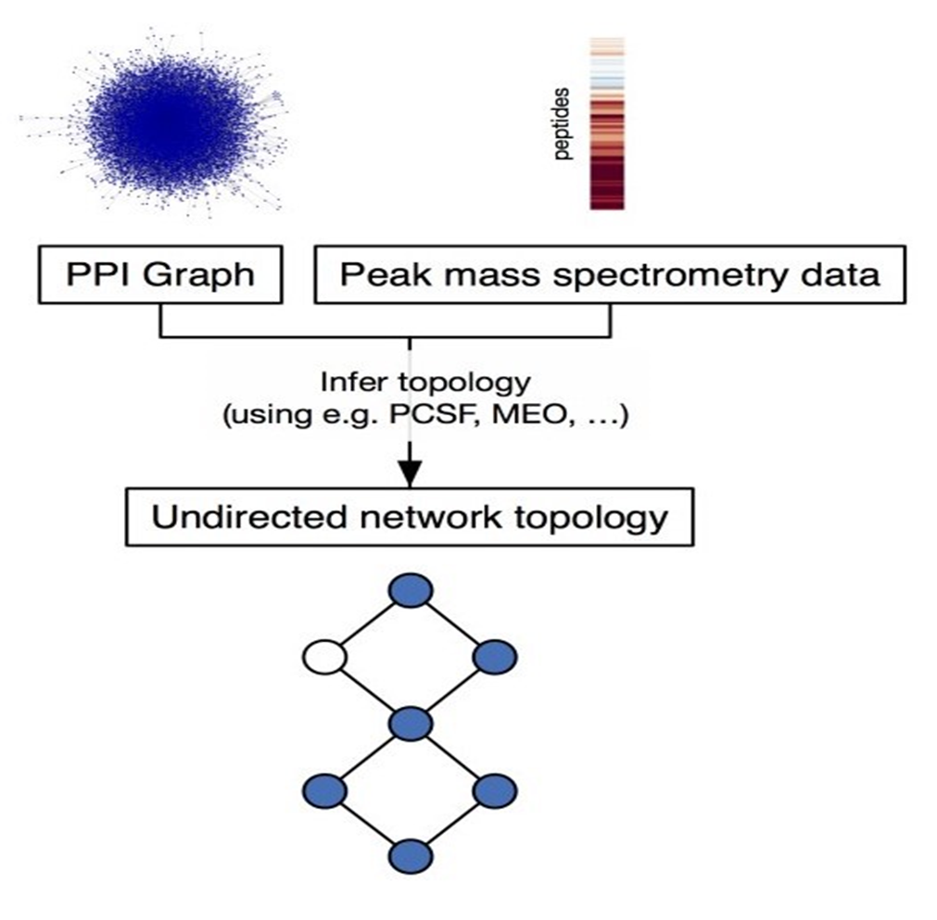
Methods
.20
.76
.90
.87
.10
.04
.18
.39
.84
.73
.31
.71

Slide 7
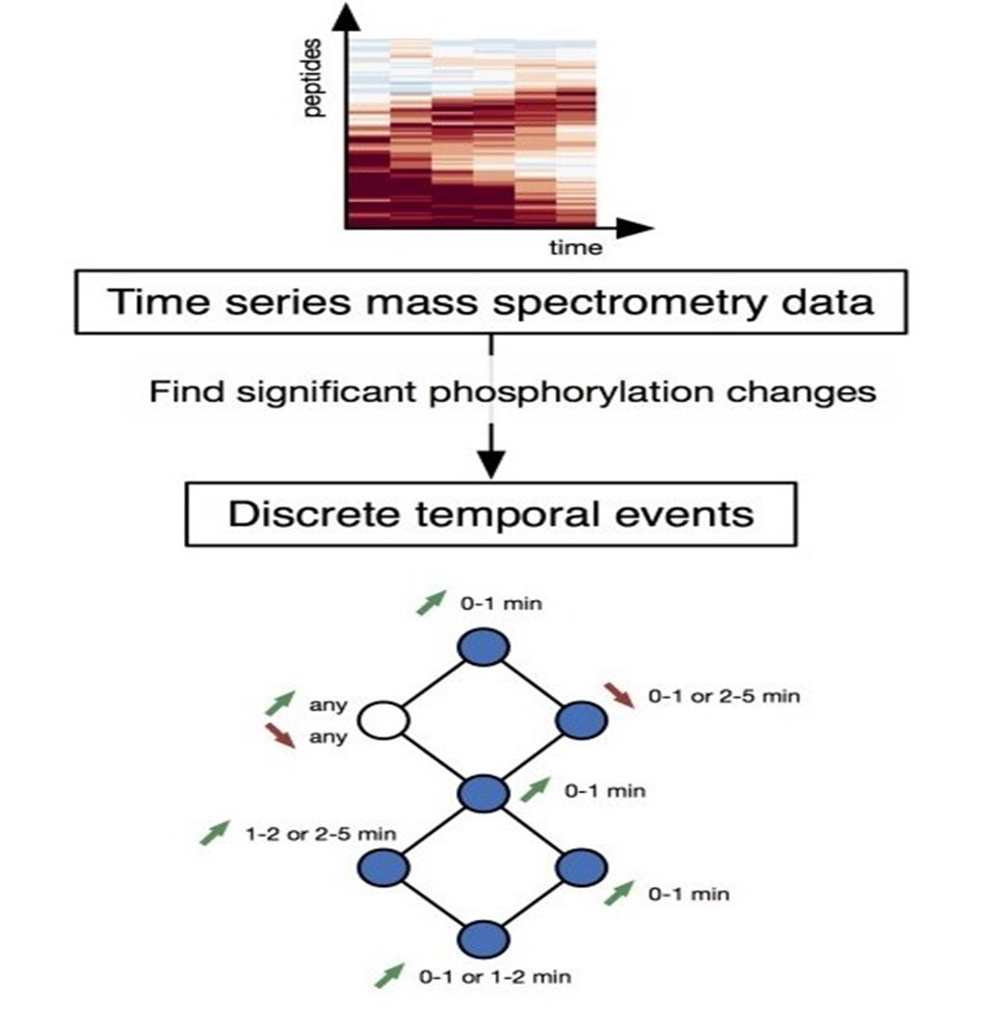
Methods
Use time series phosphorylation data to further refine the original coarse network created from the Forest module.
Assess the quality of the predicted signaling pathway using pathway databases and related literature.
Notes:
Use time series phosphorylation data to further refine the original coarse network created from the Forest module.
Assess the quality of the predicted signaling pathway using pathway databases and related literature.

Slide 8

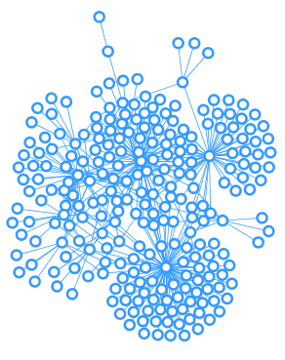
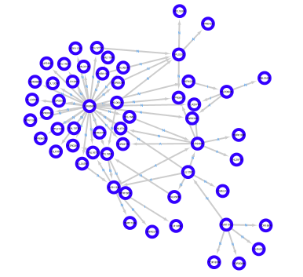
Results
PCSF
TPS
3543 Nodes
7616 Edges
250 Nodes
344 Edges
55 Nodes
72 Edges

Slide 9
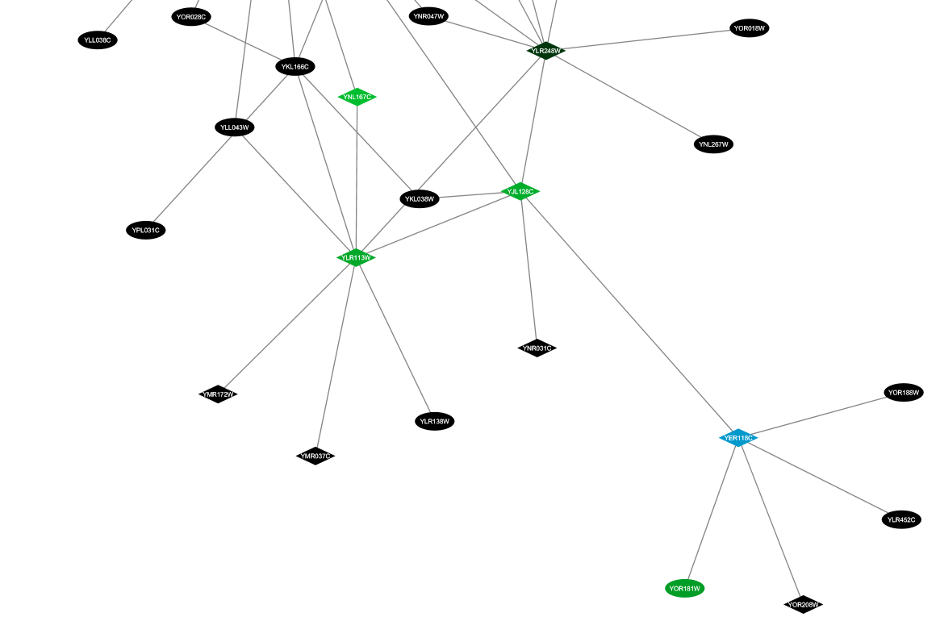
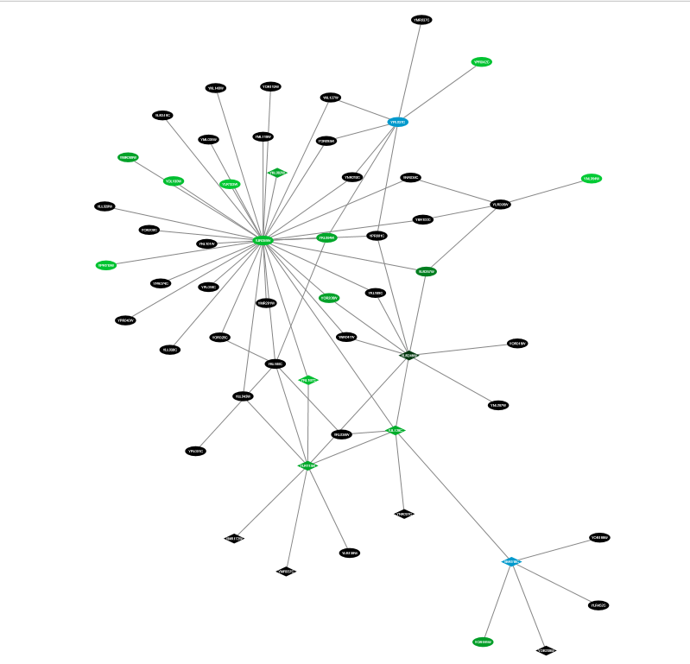
Final Network
Found In Literature for Osmotic Stress Response
Gradient of Increasing Phosphorylation Intensity
Non-Phosphorylated Protein

Slide 10
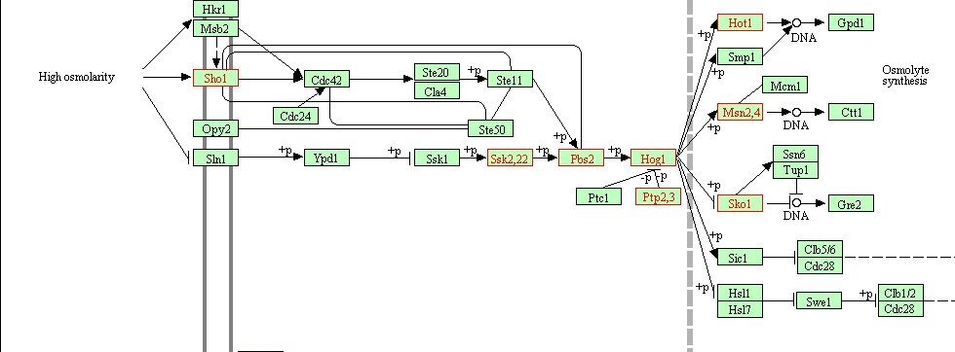
Results

Slide 11
Summary
Proteins interact with one another through phosphorylation.
A cascade of protein interactions results from some stimulus to the cell.

Slide 12



Acknowledgments
Dr. Anthony Gitter
Nafisah Islam
Dr. Amber Smith
Whitney Sweeney
Department of Biostatistics and Medical Informatics
Center for Predictive Computational Phenotyping

Slide 13
References
1. Chasman, Deborah et al. “Pathway connectivity and signaling coordination in the yeast stress-activated signaling network.” Mol Syst Biol. (2014) 10: 759.
2. Koskal, Ali Sinan et al. “Synthesizing Signaling Pathways from Temporal Phosphoproteomic Data.” Unpublished.
3. Tuncbag, Nurcan, et al. "Network-Based Interpretation of Diverse High-Throughput Datasets through the Omics Integrator Software Package." PLoS Comput Biol 12.4 (2016): e1004879.

Slide 14
Questions?

